Slide 1
Day 3 : Aggregations & Joins
Aggregate Functions: SUM(), AVG(), COUNT(), MIN(), MAX()
GROUP BY & HAVING
Sub-Queries
INNER JOIN, LEFT JOIN, RIGHT JOIN, FULL OUTER JOIN

Slide 2
Analytics tip of the day
Focus on the needs and context before the want of the stakeholder.
Differentiate Between Wants and Needs
Understand the "Why" Behind Requests
Stakeholders may ask for specific reports or metrics, but their true need might be deeper. Ask questions to uncover the real problem.
Stakeholders may request a particular solution, but a better approach may exist. Focus on the underlying business objective.
Context Shapes Insights

Slide 3
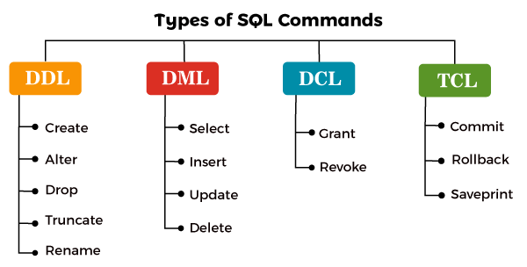
Types of sql commands
Ddl : Data Definition Language
Dml : Data Manipulation Language
Dcl : Data Control Language
TCL : Transaction Control Language

Slide 4
aliases
SQL aliases are used to give a table, or a column in a table, a temporary name.
Aliases are often used to make column names more readable.
COLUMNS ALIASES
SELECT rental_duration AS duration
FROM film;
TABLES ALIASES
SELECT ci.city, co.country
FROM city AS ci
JOIN country AS co
ON ci.country_id = co.country_id;

Slide 5
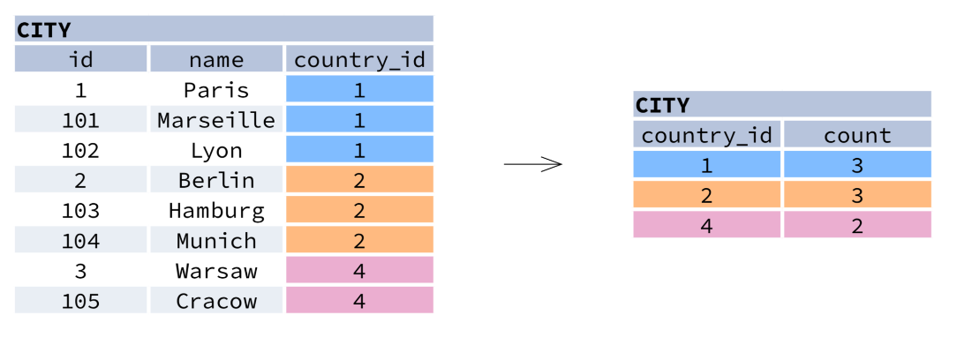
AGGREGATION AND GROUPING
GROUP BY groups together rows that have the same values in specified columns. It computes summaries (aggregates) for each unique combination of values.
SELECT COUNTRY_id, COUNT(*) FROM CITY GROUP BY COUNTRY_ID

Slide 6
AGGREGATION AND GROUPING
AGGREGATE FUNCTIONS
AVG() − average value for rows within the group
COUNT() − count of values for rows within the group
MAX() − maximum value within the group
MIN() − minimum value within the group
SUM()− sum of values within the group

Slide 7
Adding group by & having to the mix
GROUP BY
GROUP BY is used to group rows that have the same values in specified columns.
It is always used with aggregate functions (SUM(), COUNT(), AVG(), etc.).
HAVING
HAVING is like WHERE, but it filters after aggregation.
It is used to filter grouped results based on aggregate function values.

Slide 8
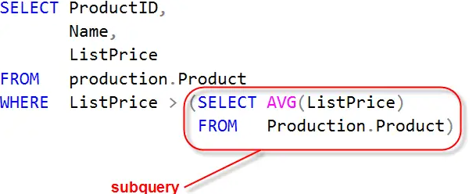
sub-queries
A subquery is a query inside another query. It is used to:
Retrieve data for the main query
Filter results dynamically
Calculate values before the main query runs

Slide 9
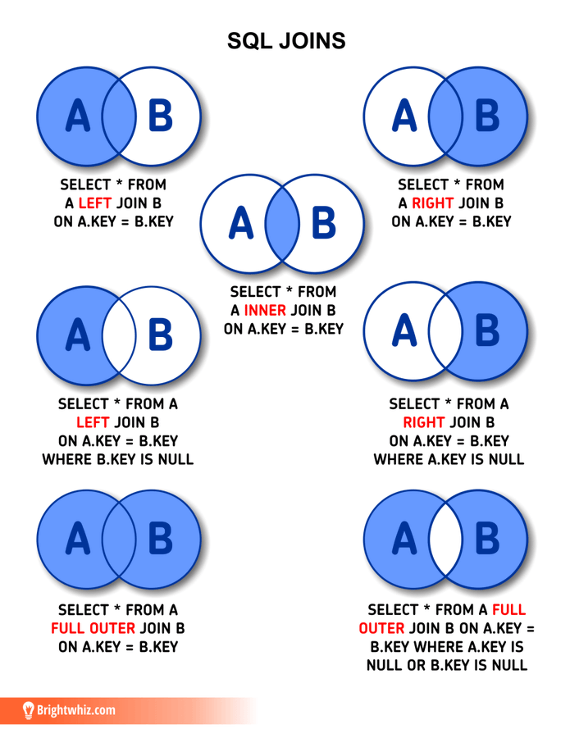
Joins
LEFT join : Get all data from left table and matching data from right.
Right join : Get all data from right table and matching data from left.
Inner join : Get only matching data between both tables.
Full join : Get all data

Slide 10
THANKS
Does anyone have any questions?
Please keep this slide for attribution.

Slide 11
Haziq zahid
Sql instructor

Slide 12
About me
BSc Computer Science
dATA aNALYST
mSC dATA SCIENCE
pRODUCT ANALYST
2016-2020
FAST, Pakistan
2020-2022
Afiniti & Retailo, Pakistan
2022-2023
Middlesex University, UK
2024-Present
Holland & Barrett, UK

